Slide 1
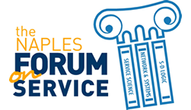
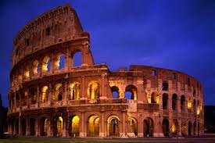
The Enhancement, Value and Viability of Cultural Heritage.
Towards a Service-Based Systems Approach
Capri, 14-17 June 2011
Sergio Barile, “La Sapienza” University of Rome
Massimo Montella, University of Macerata
Marialuisa Saviano, University of Salerno
Italy
The Colosseum , One of the Seven Wonders of the World

Slide 2

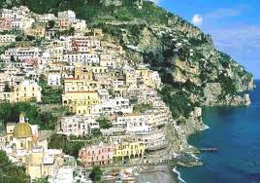
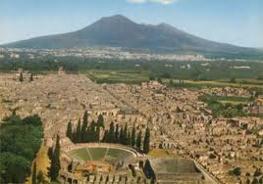
Agenda
The evolving concepts of culture and cultural heritage
The state of art in Cultural Heritage Management (CHM) in Italy
The contribution of Business Scholars
Our methodological approach
Findings and practical implications
The Faraglioni, Capri
The Amalfitan Coast
Pompeii and Vesuvius

Slide 3
Cultural goods: a cutting edge issue in the Italian political, economic and institutional debate
Culture and cultural heritage: evolving concepts
The evolution in historical terms of the conception of cultural goods has been characterized by a process of democratisation of the concept of culture, the outcome of three main factors (Golinelli, 2011):
  social and economic changes during the second half of the past century;
  the re-defining of the role of individuals in contexts and processes concerning them;
  the change in perspective in interpreting issues or phenomena, i.e. the systems thinking paradigm

Slide 4
The Italian definition of
“cultural goods”
Two contrasting perspectives coexist
“any testimony imbued with the values of civilization”
This definition conflicts in every respect with the traditional humanistic approach
Idealistic-aesthetic | Anthropological
Notes:
1. As a testimony of the cultural identity of a community
4

Slide 5
The state of the art in Cultural Heritage Management (CHM) in Italy
Government, managers, cultural operators and even citizens consider cultural heritage as a “collection of goods” mainly to conserve and protect
Management approaches focus principally on technical scientific conservation activities, which however, are far too costly to cover all cultural goods
Italian cultural goods do not attract enough demand to generate profits
The huge potential value of the cultural heritage is just “presumed”
Cultural goods necessarily have to be considered “merit goods” for their survival
Notes:
Merit goods are defined as goods or services to which the collectivity attributes a particular social value functional to the social and moral development of the community

Slide 6
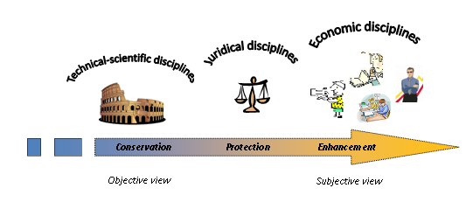
The main governance issues
the conservation of the cultural heritage, that is prevalently of a technical-scientific kind
the protection of the cultural heritage, that is prevalently of a juridical nature
the enhancement of the cultural heritage, that is of an evident multi-disciplinary nature
Notes:
Currently, in Italy, cultural goods are at the centre of the political, economic and institutional debate. Recent events (the crollo della domus dei gladiatori) together with problems that have never been resolved, inflame discussions on various levels, without however, at least to date, devising a clear cut framework in which the aims and interpretative methods of the basic issues are delineated
6

Slide 7
Business Scholars and their contribution to CHM
To date, the main contribution to CHM on the part of business scholars – tending to consider cultural goods as “products to sell” – has been, essentially, the application of marketing techniques
However, used as they are to dealing with complex phenomena, they should go beyond the reductionist (technical) approach to embrace a unitary inter-disciplinary view in line with systems thinking, helping government, managers and operators to interpret CHM
through “a systems lens”
Notes:
Here is the contribution of S-Dl
The process in itself can be material but it is intangible
7

Slide 8
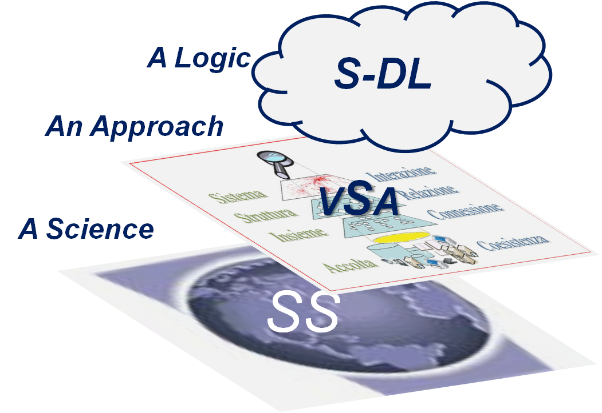
A unitary inter-disciplinary view: our contribution to CHM
We propose an integrated perspective, based on the converging ideas of Scholars of different disciplinary fields:
the Service-Dominant Logic (S-DL), as a general theory of interaction useful to a radical rethinking of the logics of CHM;
the Viable Systems Approach (VSA), as a general framework of reference for the interpretation and governance of the cultural heritage;
The Many-to-many as a network relational approach useful to involve the numerous stakeholders interested in cultural heritage governance and management;
Service Science (SS), as a (unitary) corpus of inter-disciplinary knowledge
& M-to-M

Slide 9
Our two-tier research proposal
1. Method:
to show how an integration of the (vSa), NT, S-DL, and SS frameworks can contribute to co-creating knowledge in the field of Service Science
2. Context:
to highlight how the CHM approach in place in Italy:
suffers from the limits of a traditional Goods-Dominant Logic, excessively focused on a technical-scientific conservation of cultural “objects” and
can benefit from the opportunities of a new vision of cultural heritage where its multi-dimensional, multi-stakeholder and multi-disciplinary nature clearly emerges.

Slide 10
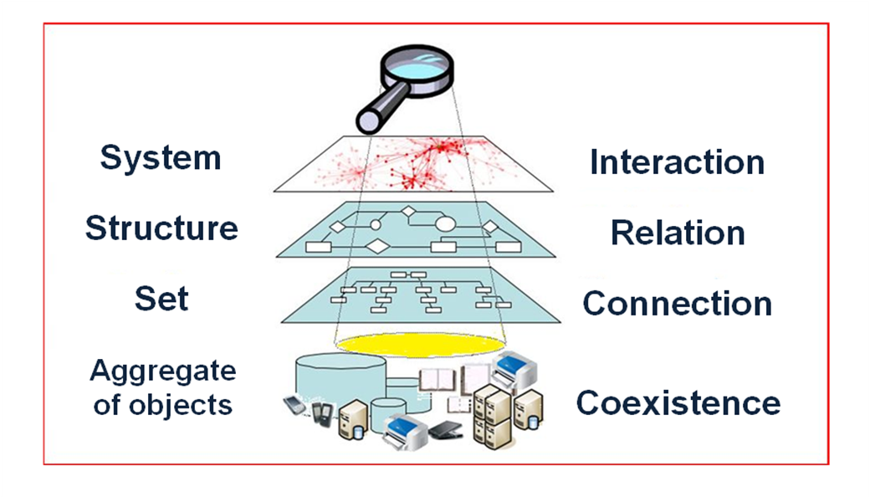
The (VSA) as framework of reference
On the basis of the structure-system paradigm, (vSa) envisages fundamental shifts in perspective
(Beer, 1972; Golinelli, 2000, 2005, 2010; Barile, 2000, 2006, 2009):
    reductionist relational systems approach
    parts relations whole

Slide 11
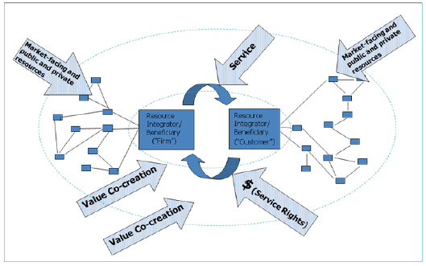
The S-Dl as theory of interaction
the shift from a Goods-Dominant Logic to a Service-Dominant Logic in which value is generated in context and dynamically
(Vargo and Lusch, 2004; Lusch and Vargo, 2006; Brodie at al., 2006; Gummesson E., Lusch R.F., Vargo S. L., 2009, Gummesson E., 2010).
corresponds to the shift from a reductionist to a systems approach
In S-DL, value is not “incorporated” in the product or service but is a value proposition and emerges in the process of co-creation as value in use.
Focus is on interaction in line with a systems thinking perspective.
Notes:
the diverse players involved in the process of exchange, acting as integrators of resources, interact on the basis of a mutual agreement relative to reciprocal value proposition

Slide 12
The Many-to-many as network relational approach
It suggests a shift from parts to relations that marks the turning point in the change of paradigm
(Relationship Marketing, Gronroos, 1996; Gummesson, 2008)
the broader perspectives of the Network Theories
(Lorenzoni, 1992; Hakansson et al., 2009; Stampacchia, 2009)
distinguishing between the dyadic and network level of relations
(Golinelli, 2010, 2011) suggest a further shift in focus
from a one to one (dyadic) relation to a many to many (network) configuration (Gummesson, 2004; 2006), that represents a more suitable structural organization for complex service systems (Barile and Polese, 2010).

Slide 13
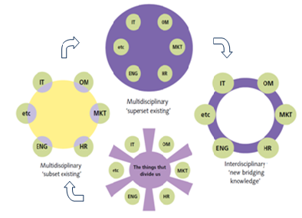
The SSME as a corpus of inter-disciplinary knowledge
Suggesting the opportunity to construe a general corpus of knowledge for the management of service systems, SSME proposes
a shift from a multidisciplinary to an interdisciplinary approach
(Spohrer and Maglio, 2007; Maglio and Spohrer, 2008; Spohrer and Kwan, 2008; Maglio et al., 2009, 2010; Spohrer et al., 2010; Ng et al., 2010).
Source: Adapted from IfM and IBM. 2008:11.

Slide 14
Findings
Towards an innovative vision of cultural heritage and cultural value
Towards an innovative service-based systems perspective (the “Goods-Product-Service” Matrix of cultural heritage)
Towards a triple target of sustainable viability for cultural heritage
Towards a Many-to-many network approach for the governance of a Cultural Heritage Territorial System

Slide 15
1. Towards an innovative vision of cultural heritage and cultural value
A shift
from a traditional dominant view of cultural “goods”
object-based, static, structural, tangible
presumed intrinsic value
(cultural goods exposed in museums)
to a new service conception of cultural heritage
subjective, process-based, dynamic, contextual, interactive, systemic, intangible
emergent value in use
(testimony of communities’ cultural identity through cultural service systems)

Slide 16
“New” insights from our “knowledge heritage”
The shift from a “tangible” to an “intangible” view suggests to more deeply understand the meaning of the attribute “tangible”, that, in effect, seems to express the possibility of delimiting and drawing boundaries of the observed object.
The need, in actual fact, is to delimit:
a specific cause connected to
a specific effect, which achieves
a specific aim.
This concept reminds us of the ever valid (viable) cultural value of the great Thinkers of the past!

Slide 17
The Aristotle’s heritage
The Theory of Aristotle’s Four Causes, with regard to what an object will become in the future, distinguish (Stanford Encyclopedia of Philosophy):
  a material cause, indicating what an object is made of (in the case of a statue, for instance, bronze);
  a formal cause, indicating the form the object will acquire (the form of the statue);
  an efficient cause, indicating what produces an object, what the process achieves (in the case of a statue, the sculptor, the art of bronze-casting);
  a final cause indicating the end for which the object is made (in the case of the statue to venerate a divinity).
According to Aristotle, while the material cause and the formal cause offer a full explanation (description) of objects observed from a static perspective, they are no longer sufficient to explain what they will become, when considered from a dynamic perspective. Two further reasons or causes are necessary: the Efficient Cause and the Final Cause.
According to Aristotle all the sculptor does in casting the statue is to manifest specific knowledge. This knowledge, not the sculptor who has mastered it, is the salient factor for explaining the efficient cause.
Notes:
Aristotle explains that with regard to what the object will become in the future, the causes involved, consist in four:

Slide 18
The Aristotle’s heritage
In the light of Aristotle’s view, we can distinguish:
- a concept of value linked to the material cause and formal cause (the presumed “intrinsic” value of the goods)
- a concept of value linked to the efficient and final cause (the effective value in use of the goods)
Thus there is shift:
from a tangible view of cultural goods (reductionist, static, objective) to an intangible view (systemic, dynamic, subjective)
from the “presumed” intrinsic value to the effective value in use, subjective and contextualized, emerging in the perception of the beneficiary

Slide 19
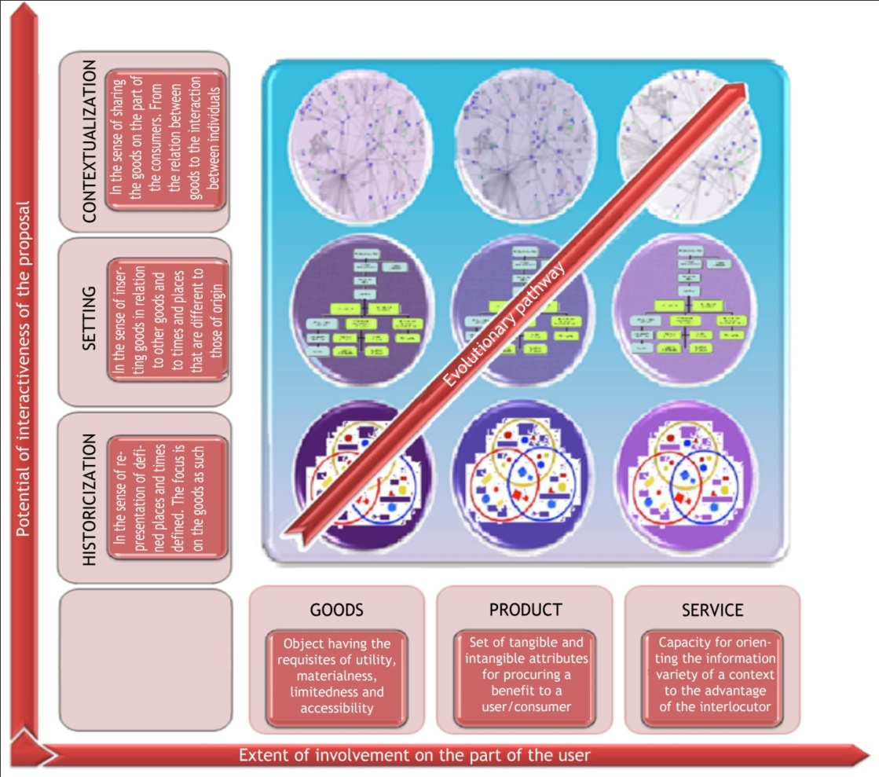
2. Towards an innovative service-based systems perspective through the “Goods-Product-Service” Matrix of cultural heritage
The first dimension is “the extent of involvement on the part of the user”
The second dimension is “the potential of interactiveness of the proposal” (the cultural offering)

Slide 20
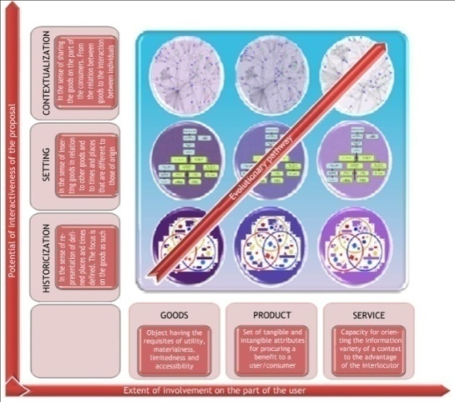
The GPS Matrix of the cultural heritage
In the original view of “goods” where cultural goods are seen as detached from their context.
In the later view of “product”, the proposer selects and organizes the potential options to offer in a pre-defined pathway with respect to clearly identified functions of use.
In the proposed view of “service”, the goods should be presented with wide margins of freedom. The distinctive characteristics of the goods should be co-created with the user . Value should emerge contextually and dynamically as value in use.
The historicization approach: priority aims are collecting and preserving cultural “goods”. The focus is on the goods as such.
The relational approach: proposes different environments in which goods are inserted in relation to other goods and to time and places different from those of origin.
The contextualization approach aims to create conditions of sharing involving the user in the process. The content of the service emerges dynamically through interaction with the user.

Slide 21
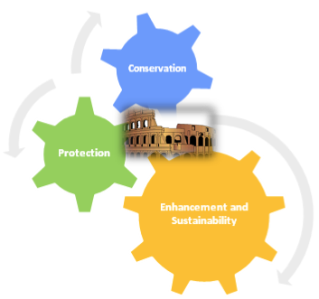
3. Towards a new triple target of sustainable viability for cultural heritage
In the light of the new vision, conservation, protection and enhancement trigger a virtuous circle resolving the traditional (false) dilemma conservation vs enhancement.
Rejecting a reductionist approach, the governing body has to put in place balanced strategies of action:
to conserve the structure
and
to enhance the systems viability
of cultural heritage, strongly related to the target of sustainability.
Notes:
Sustainability means using natural and cultural resources so that their capacity to meet human needs into the future is not diminished.

Slide 22
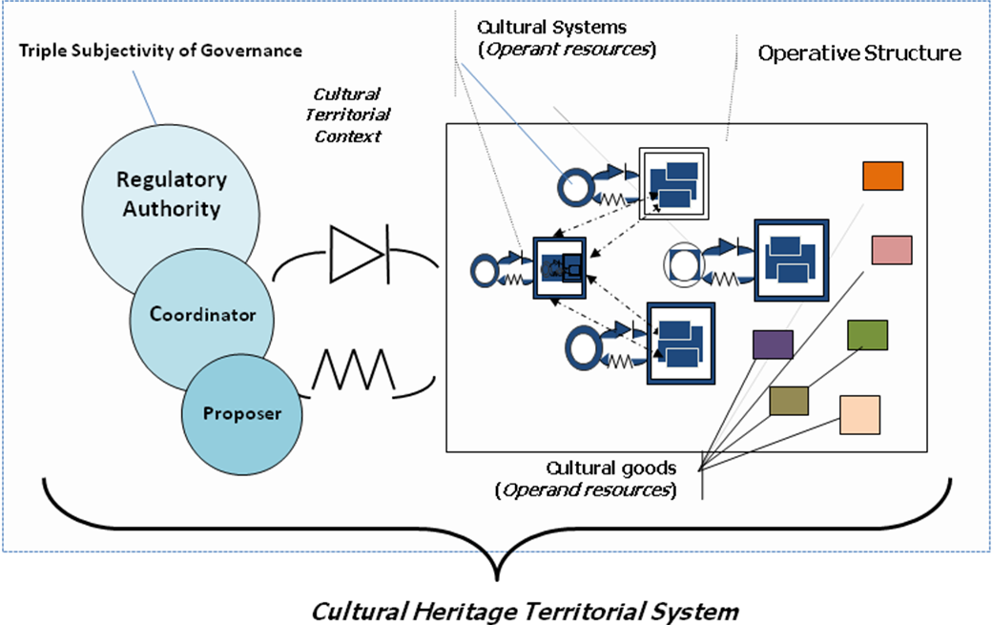
4. Towards a new Many-to-many network approach for the governance of cultural heritage
In sum, our general interpretation scheme addresses the idea of going towards a Cultural Heritage Service System emerging from a Cultural Heritage Territorial System, the implementation and governance of which are underpinned by the proposed integrated framework.

Slide 23
The Cultural Heritage Territorial System
From an S-Dl perspective, we distinguish between (Lusch e Vargo, 2008):
cultural goods as time and place specific components of the territory that are “operand” resources
cultural organizations (systemic components) as fundamental “operant” resources
In order to converge towards a consonant MtoM configuration, a key decision making role in governing the network is played by a triple subject of governance:
  the Regulatory Authority, the decision maker who defines pillars of action for the territory (e.g. the Ministry of Cultural Heritage and Environmental Conservation);
  one or more Coordinators, capable of developing proposals for each line of action identified by the decision maker (e.g. Unesco National Commissions);
  one or more Proposers, public or private, engaged in the realization of the projects proposed by the Coordinators.

Slide 24
Concluding remarks
In the light of our view,
cultural value is never “consumed” during the experience of enjoyment, but is transformed and enriched
by combining and re-combining with the variety both of the beneficiary and of any other resources integrator involved in the interaction process .
(Vargo and Lusch, 2006; Barile, 2009, 2011; Piciocchi, Saviano, and Bassano, 2011).

Slide 25
A call for Business Scholars
This is a call for the contribution
of business scholars to work together
to co-create knowledge
for the viability of OUR cultural heritage.

Slide 26
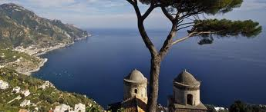
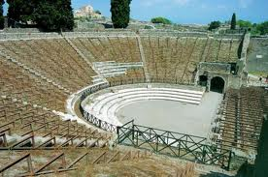
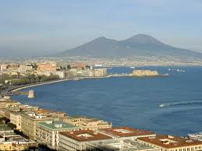
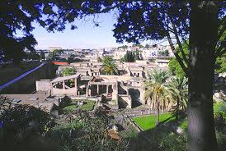
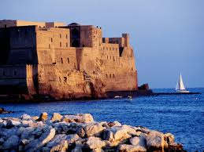
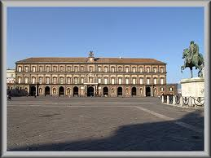
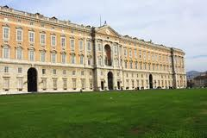
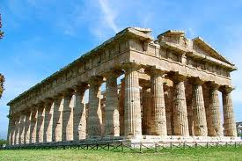
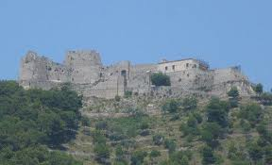
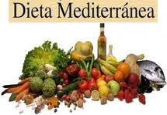
Do Enjoy Our Cultural Heritage!!
The Amalfitan Coast, View from the 13th Century Villa Rufolo in Ravello
The Large Theatre, Pompeii
Herculaneum Ruins
Royal Palace, Naples
Royal Palace, Caserta
Castel dell’Ovo, Naples
The Temples, Paestum
Including our Mediterranean Diet!!
Arechi Castle, Salerno

Slide 27
The intangible cultural heritage
“The ‘intangible cultural heritage’ means the practices, representations, expressions, knowledge, skills – as well as the instruments, objects, artefacts and cultural spaces associated therewith – that communities, groups and, in some cases, individuals recognize as part of their cultural heritage. This intangible cultural heritage, transmitted from generation to generation, is constantly recreated by communities and groups in response to their environment, their interaction with nature and their history, and provides them with a sense of identity and continuity, thus promoting respect for cultural diversity and human creativity. (…)”
(Art. 2, par 1, UNESCO 2003 Convention on the Safeguarding of the Intangible Cultural Heritage)

Slide 28
Contrasting perspectives
Idealistic-aesthetic | Anthropological
Cultura animi | Civilisation
Rareness | Every testimony of civilisation
Excellence | Common and serial production which narrate better the common conditions of existence
Beauty | Reliable historical information
Monuments | Random documentation
Ideal value, absolute | Material value, historical
Value for its own sake, individuality | Systemic value, context
Universal value | Time and place specific
Value of belonging | Value in use
Admiration, emotion | Intelligence, knowledge
Conservation in museums | Conservation as continuity of use, maintenance, sustainable development, urban planning
End of the pipe restoration of single objects | Prevention, reduction of damage with intervention on a territorial scale to contrast factors of environmental decay
Source. Montella, forthcoming.
Notes:
Although the idealistic Humanistic perspective still prevails in the approach to c.h. management
28

Slide 29
The World Heritage List
World Heritage List (January 2011): 911 sites (704 of cultural kind, 180 natural and 27 mixed).
Italy is the first Nation in the world for number of sites in the List with 45 sites (42 “cultural” and 3 natural (Isole Eolie, Dolomiti and Monte San Giorgio)
( http://whc.unesco.org/en/list)

